Slide 1
Welcome New Students
Overview of Campus life

Slide 2
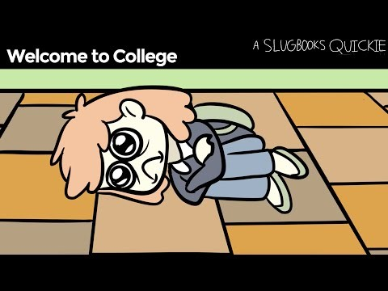

Slide 3
Why Choose Us?
Beautiful campus
Experienced professors
Low cost for attendance

Slide 4
Campus Life Benefits
New, modern co-ed dorms
Recently renovated
Best food cooked by top chefs
Designed to cultivate your dining experience
Easy walking to parks
No car needed!

Slide 5


Slide 6
Welcome
Campus
Graduates

Slide 7

Graduation

Slide 8


2016 Graduates

Slide 9


Hmm.. Should I go back to school?

Slide 10
College Team Members
John Tanner
President
Molly Timmerland
Legal Counsel
Kenny Dooer
IT Director
Carol Jones
Board of Directors

Slide 11
Board of Directors
Pam Moore
Board Chair
Tom Allen
Vice Chair
Jimmy Gooding
Committee Chair
Gerald Rainey
Treasurer

Slide 12
Student Advisory Board
Students
James Allan
John James
Jenny Haynes

Slide 13
Next Steps
Apply
Find $$
Register for classes

Slide 15
Continuing Education

Slide 16
Student Count
Great Job St. Phillips!

